Slide 1
Deep Learning Course Outline
Farid Afzali, Ph.D., P.Eng.

Slide 2
Your Gateway to Deep Learning Excellence
This course is designed to provide you with in-depth knowledge of deep learning, a technology that is shaping the future.
Abundant Learning Resources: You'll have access to a wealth of learning materials and resources.
Skill Development and Real-World Applications: By the end of this course, you'll be equipped with the skills and knowledge to tackle real-world problems using deep learning.

Slide 3



About me
Now, I am a Principal Data Scientist at Infor Company.
Professional experience of +9 years as a Data Scientist /Advanced Process Control Specialist and Data Scientist at Hatch Ltd Company, Mississauga.
Ph.D. in Chemical Engineering, Proficiency in Statistical Modeling, Machine Learning, Deep Learning, and Credit Risk Modeling
Worked with Prof. Mahalec
I am a Professional Engineer under PEO.
Proficiency in Optimization, Stochastic Optimization, Systems Modelling, Advanced Process Control, and Supply Chain Management.
Sessional Faculty at McMaster University, Systems Modelling and Optimization, 2020.
Sessional Faculty at McMaster University, Cyber Physical Systems and Industry 4.0, 2023, 2024.
Sessional Faculty at McMaster University, Machine Learning and Artificial Intelligence, 2023,2024
Sessional Faculty at McMaster University, Deep Learning, 2023,2024.
Sessional Faculty at McMaster University, Cloud Computing, 2023,2024.

Slide 4
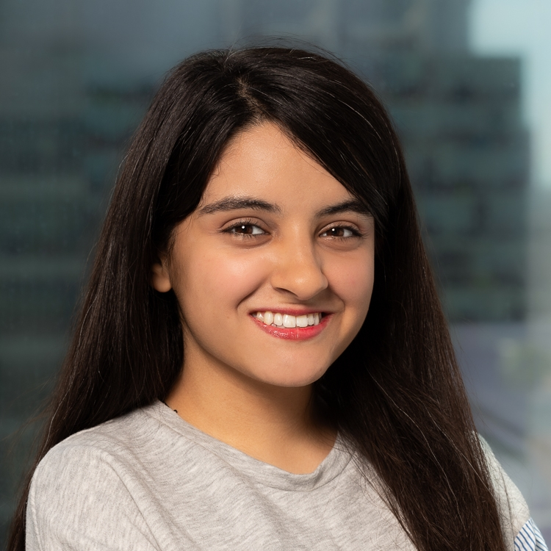
About teaching assistant
Taraneh Ghandi, Ph.D. student in Computational Science and Engineering​
Research: Developing Foundational Models for Shape Understanding​
Experienced in:​
Deep Learning​
Machine Learning​
Computer Vision​
Python Programming Language​
Contact Information:​
McMaster Email: ghandit@mcmaster.ca​

Slide 5
Why Choose Our Deep Learning Course?
Comprehensive Content: We cover a wide range of deep learning topics, ensuring you get a holistic understanding.
Abundance of Real-Life Examples: You'll find numerous practical examples to reinforce your learning.
Easy-to-Follow Material: Our course materials are designed to be accessible and user-friendly.
No Mid-term or Final Exams: You won't be burdened with traditional exams, allowing you to focus on learning and projects.

Slide 6
Hands-On Projects, Quizzes and Bonuses
One Final Projects (Topic of Your Choice): You have the freedom to choose project topics that interest you, promoting creativity and real-world problem-solving. You have to apply our coding practice to perform your project.
Group or Individual Work: Whether you prefer working independently or collaborating with peers, our course accommodates both.
Quizzes: Prepare yourself to thoroughly understand and retain the deep learning concepts taught in class. The quizzes will cover various topics, including real-world questions frequently encountered by data scientists and AI professionals during job interviews, ranging from entry-level to senior positions.
Quizzes will be conducted in person during class sessions. If you are unable to attend, you may arrange to take the quiz at another time with prior permission (maximum 2 quizzes can be done later with not more than two quizzes passed the quiz date). If taken remotely, quizzes will be graded at 65% of their total possible score.
Class activity: Engage in numerous hands-on exercises, coding practices, and real-world project activities designed to ensure a comprehensive understanding of deep learning principles.
Optional Bonus Assignments: Challenge yourself with optional assignments to earn bonus points and deepen your understanding.
Group Collaboration in Class: Our classes are interactive, and you'll actively collaborate with classmates to solve real problems.

Slide 7
Becoming a Deep Learning Expert
Mastering Deep Learning and Model Deployment: This course will equip you with the skills needed to master deep learning models and deploy them in real-world scenarios.
Real-Time Application Problem Solving: You'll be well-prepared to address real-time challenges and apply deep learning solutions effectively.
Confidence in Tackling Challenges: By the end of this course, you'll have the confidence to take on complex problems and contribute to the field of deep learning.

Slide 8
Week 1-2: Introduction to Deep Learning
Week 1: Course Introduction and Overview of Deep Learning
Week 2: How Deep Learning Works: Neural Networks, Activation Functions, and Forward Propagation
Learning Outcome: Understand the fundamental concepts of deep learning and neural networks.

Slide 9
Week 3-4: Python Tutorial for Deep Learning
Week 3: Python Basics for Deep Learning
Week 4: Numpy and PyTorch for Deep Learning
Learning Outcome: Acquire essential Python skills and understand the tools used for deep learning in Python.

Slide 10
Week 5-6: Optimization and Training
Week 5: Gradient Descent and Backpropagation
Week 6: Artificial Neural Networks (ANN)
Learning Outcome: Understand optimization techniques and the structure of artificial neural networks.

Slide 11
Week 7: Overfitting, Cross-Validation, and Regularization
Understanding the concept of overfitting.
Factors that contribute to overfitting in machine learning models.
Techniques and strategies to prevent or reduce overfitting.
Learning Outcome: Learn how to address overfitting and use regularization techniques.

Slide 12
Week 8-9: Hyperparameters and Feedforward Neural Networks (FFN)
Week 8: Hyperparameters (Activations and Optimizers)
Week 9: Feedforward Neural Networks (FFN) and Model Evaluation
Learning Outcome: Gain expertise in selecting hyperparameters and evaluating FFN models.

Slide 13
Week 10-11: Advanced Topics in Deep Learning
Week 10: Milestone Projects with Feedforward Networks
Week 11: Autoencoders and Model Weight Initialization
Learning Outcome: Apply deep learning concepts to practical projects and understand autoencoders.

Slide 14
Week 12: GPU Computing and Convolutions
What is GPU and why use it?
Implementation
Run an experiment on the GPU
Learning Outcome: Learn how to run deep learning models on GPUs and understand convolutional neural networks (CNNs).

Slide 15
Week 13: Convolutional Neural Networks (CNNs)
Overview of the fundamental architecture of Convolutional Neural Networks (CNNs).
Using CNNs to classify handwritten digits in the MNIST dataset, a common deep learning task.
Learning Outcome: Explore CNNs, transformations, and design principles.

Slide 16
Week 14: Advanced Deep Learning Topics
Week 14: Transfer Learning, Style Transfer, Generative Adversarial Networks (GANs), Recurrent Neural Networks (RNNs), LSTM, GRU, and Ethics of Deep Learning
Learning Outcome: Familiarize students with advanced topics and ethical considerations in deep learning.

Slide 17
Course Learning Outcomes
Understand the core concepts of deep learning, including neural networks, activations, and optimization techniques.
Gain proficiency in Python, Numpy, and PyTorch for deep learning applications.
Apply gradient descent and backpropagation to train artificial neural networks.
Recognize and mitigate overfitting through cross-validation and regularization techniques.
Choose appropriate hyperparameters and optimizers for deep neural networks.
Build and evaluate feedforward neural network models for various applications.
Work on milestone projects to develop practical deep learning skills.
Explore autoencoders, GPU computing, and convolutional neural networks.
Understand advanced topics such as transfer learning, style transfer, GANs, RNNs, LSTM, GRU, and ethical considerations in deep learning.

